Slide 1

E-commerce Application preventing SQLi
A Presentation by
Akshitha Reddy
Arvind Kumar
Chiranjeevi Maddu
Jithendra Chowdary
Neeharika

Slide 2

Contents
Introduction
Technical Stack
UI
Database
SQLi
SQL map

Slide 3
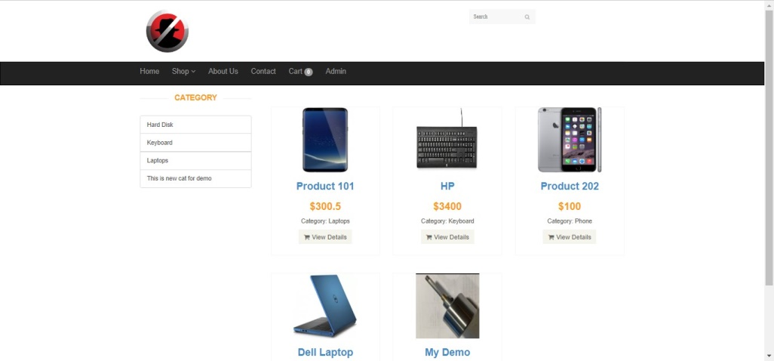
Introduction

Slide 4


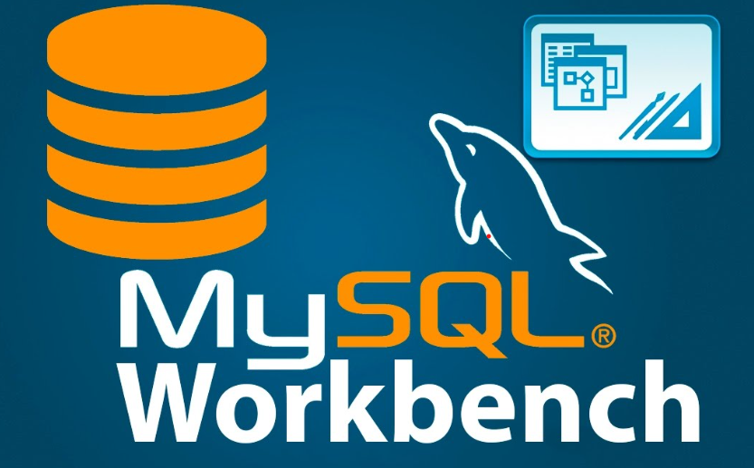

Technical Stack
Tools and Technologies
MYSQL
APACHE
XAMPP
SQLMap
Languages
PHP
SQL

Slide 5
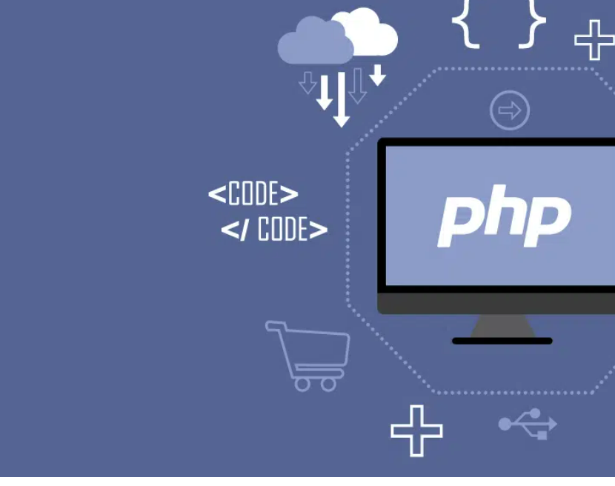
Server-Side scripting language
Open source and community driven
Is designed to embed within HTML
It is supported by all major operating systems and web servers
Interpreted language
What Is Php ?

Slide 6
Php Implementation
1.Dynamic content
Based on user input
Retrieving data from the database
2. Server-side processing
3. Integration with database

Slide 7
Home Page and basic Functions

Slide 8
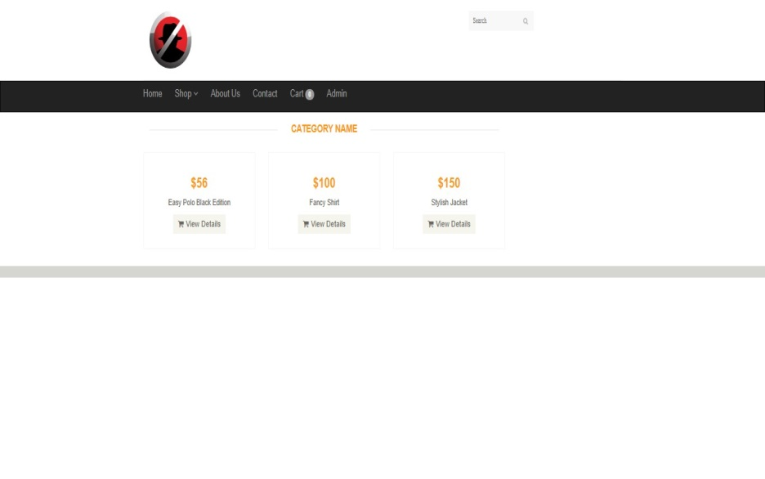
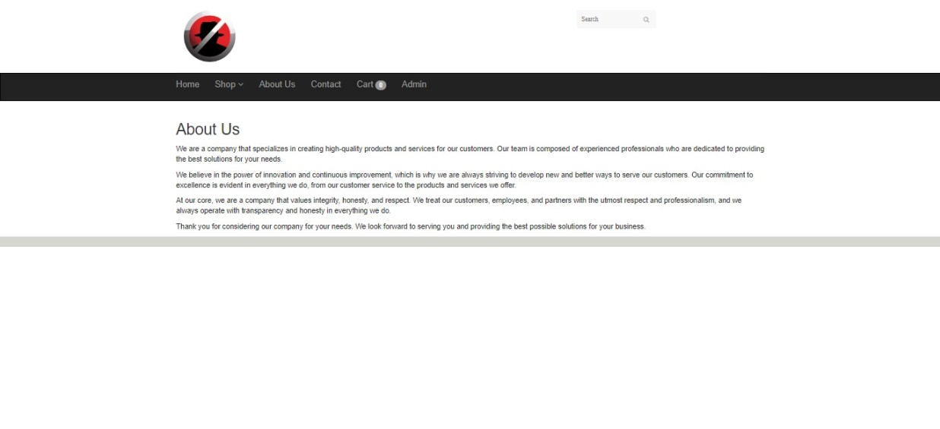
Category
About Us

Slide 9
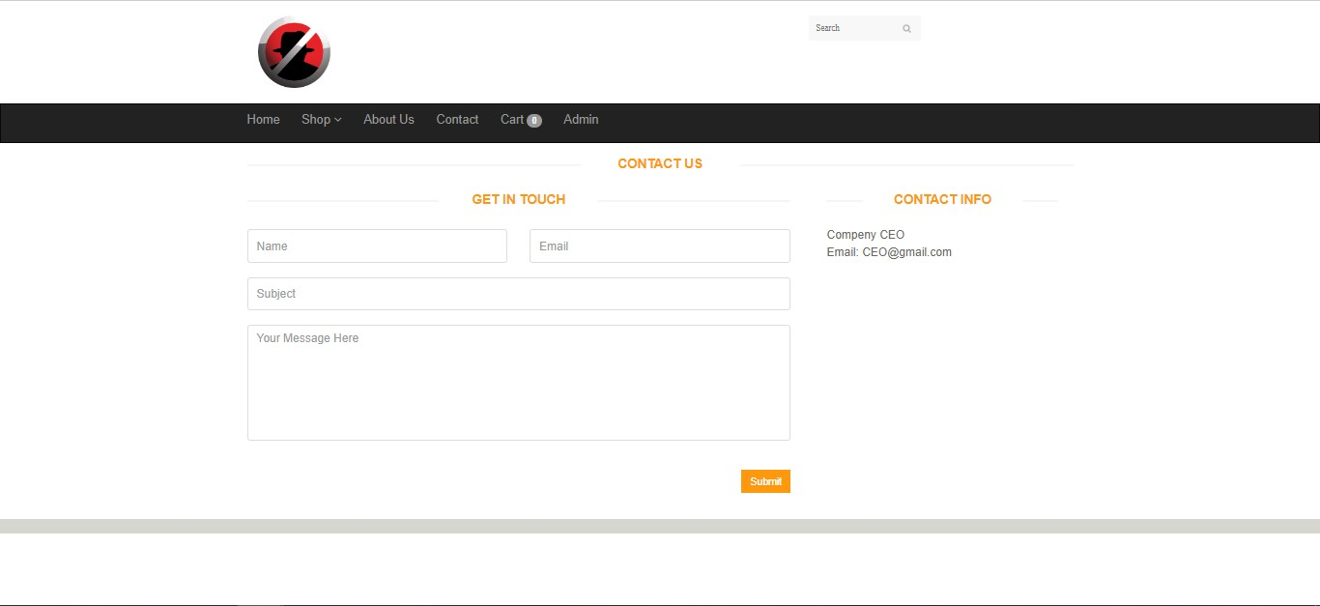
Contact Us Page

Slide 10
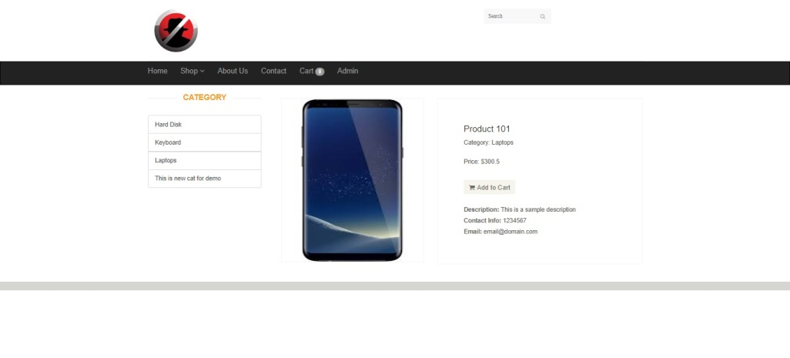
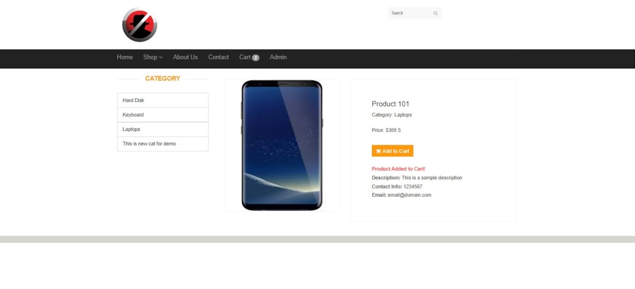
Product Page And Adding Into Cart

Slide 11
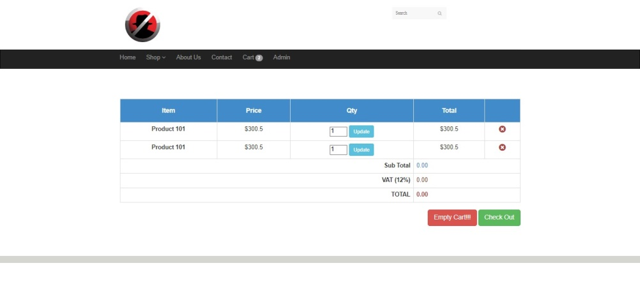
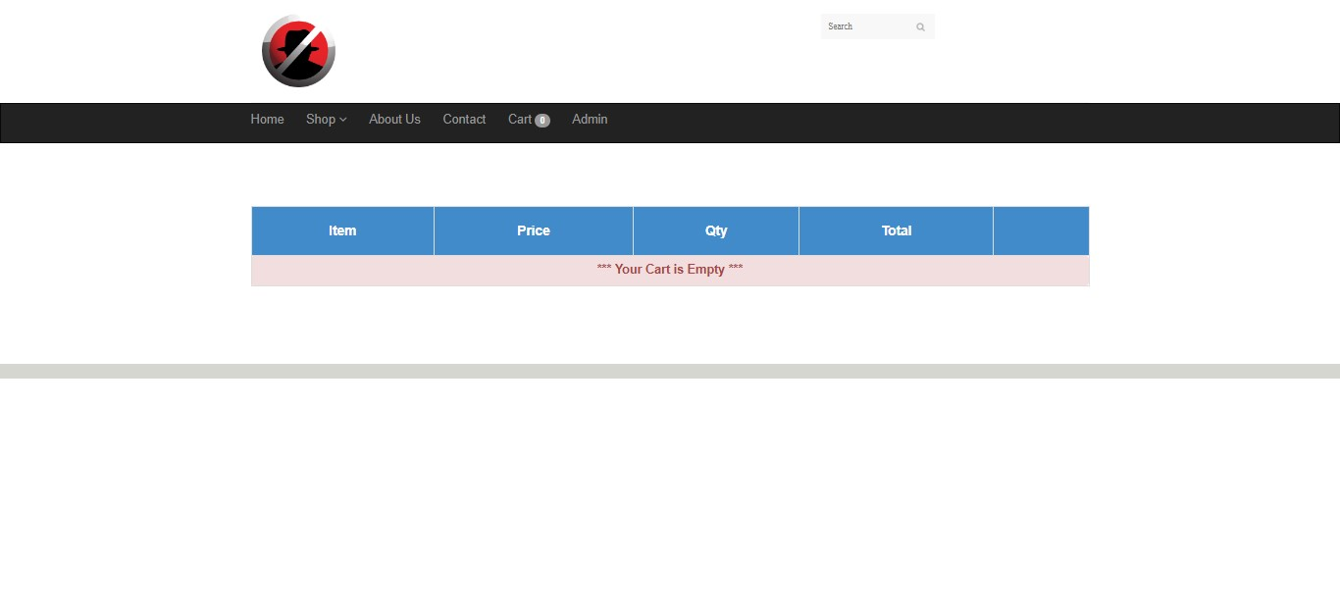
Items in Cart
Empty cart

Slide 12
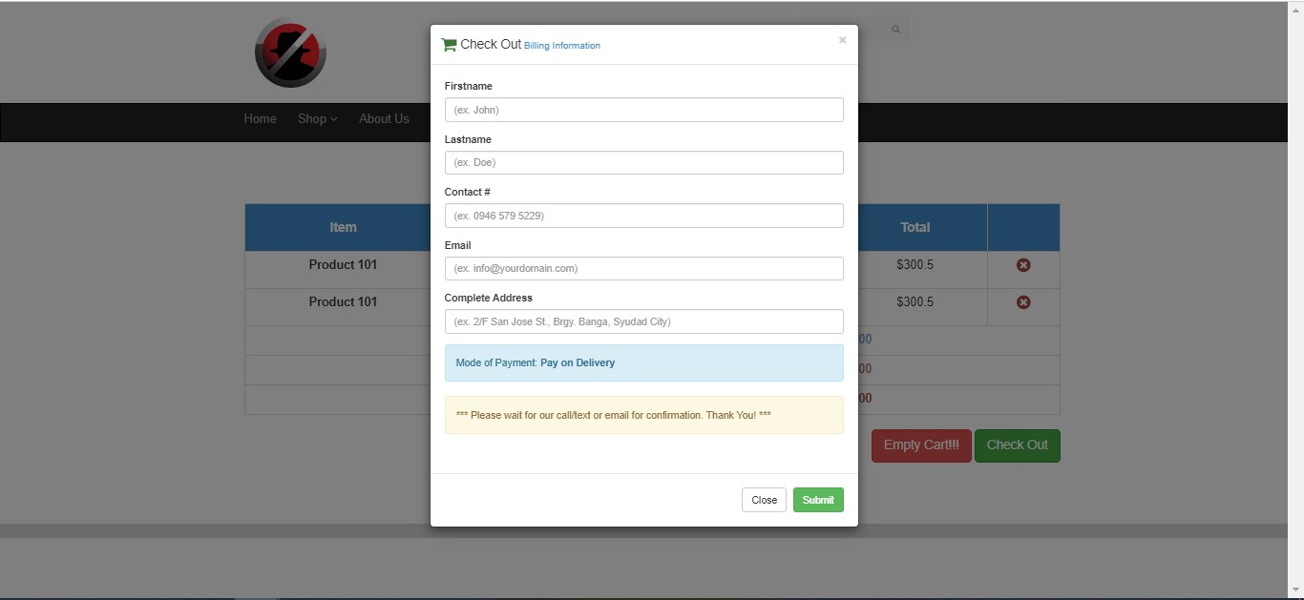
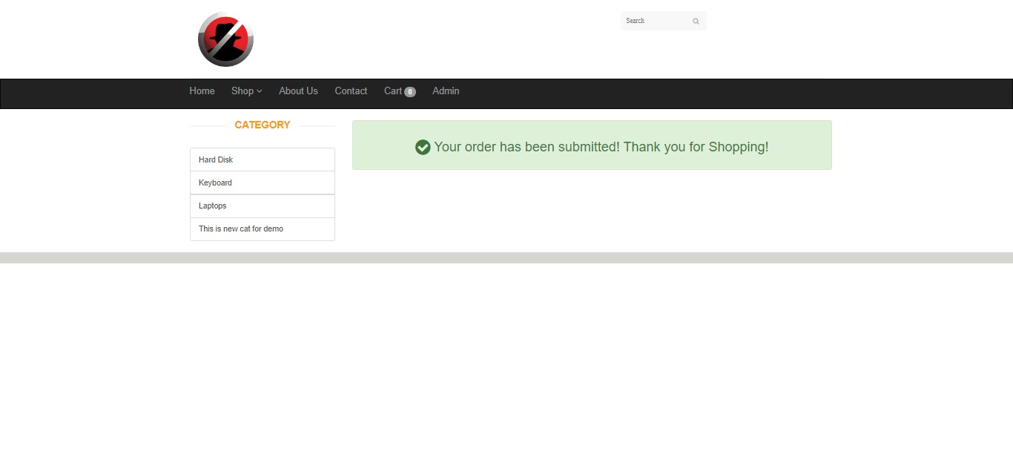
Payout
Checkout

Slide 13
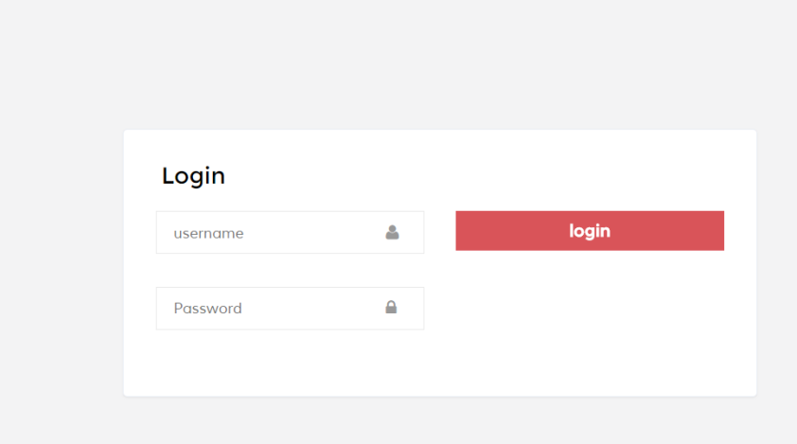
Admin Login
This is the page that can give access so we have to prevent on this page to sqli

Slide 14
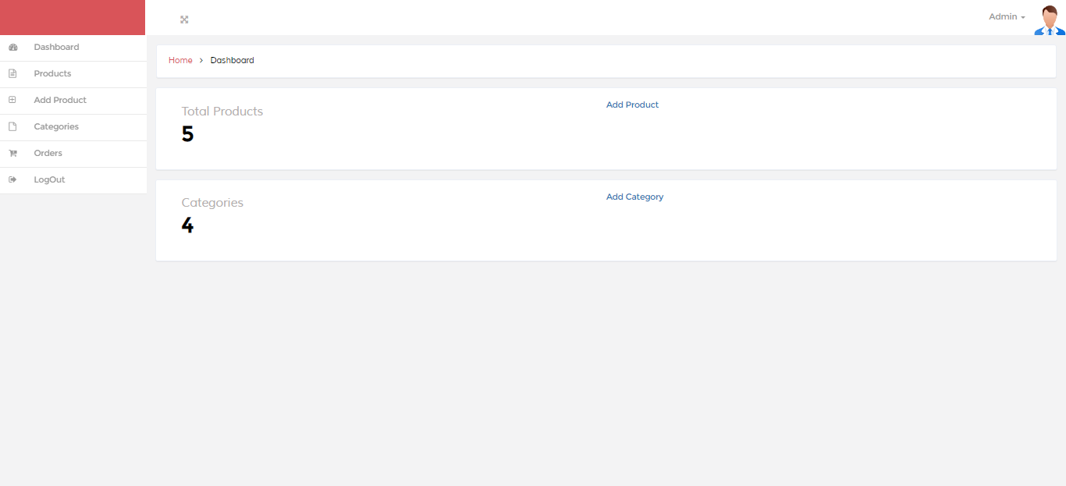
Dashboard

Slide 15
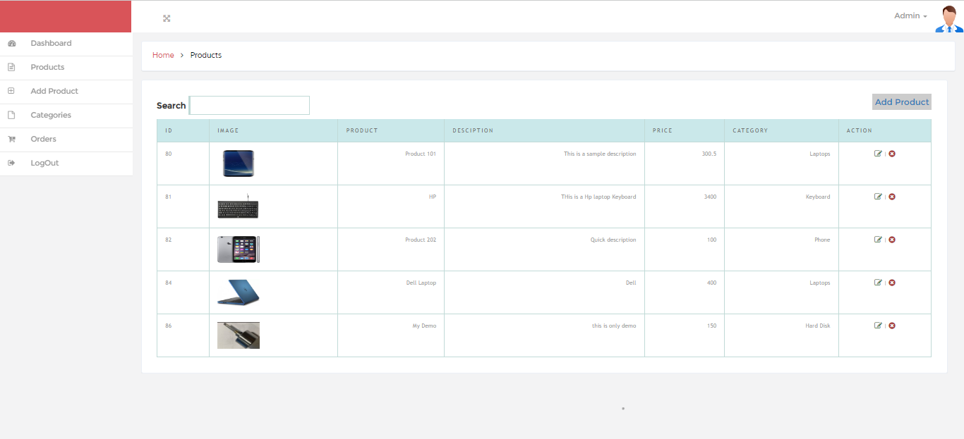
Product Check

Slide 16
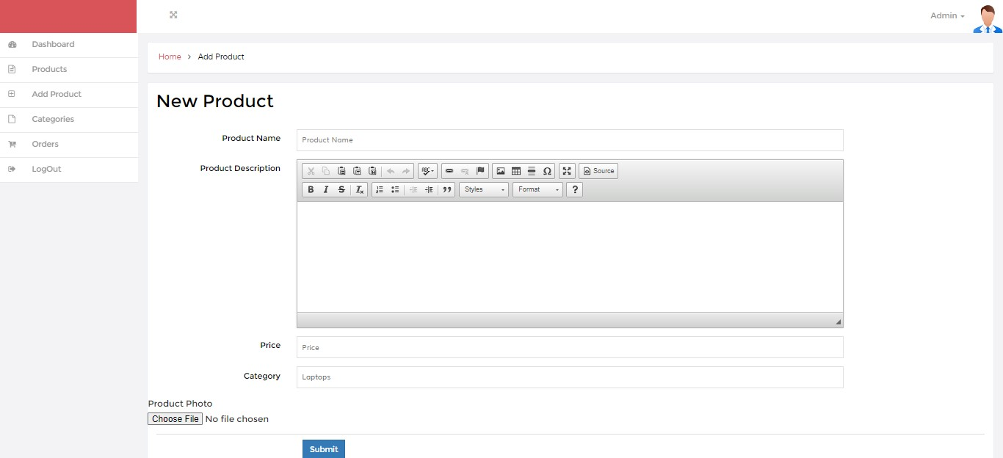
Admin Features
Add Product

Slide 17
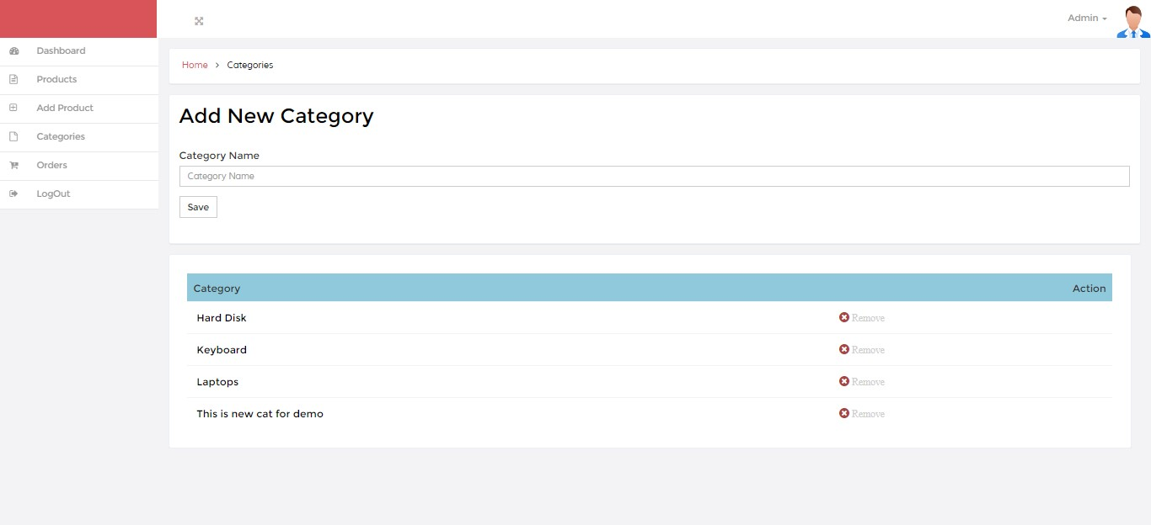
Add And
Edit Category

Slide 18
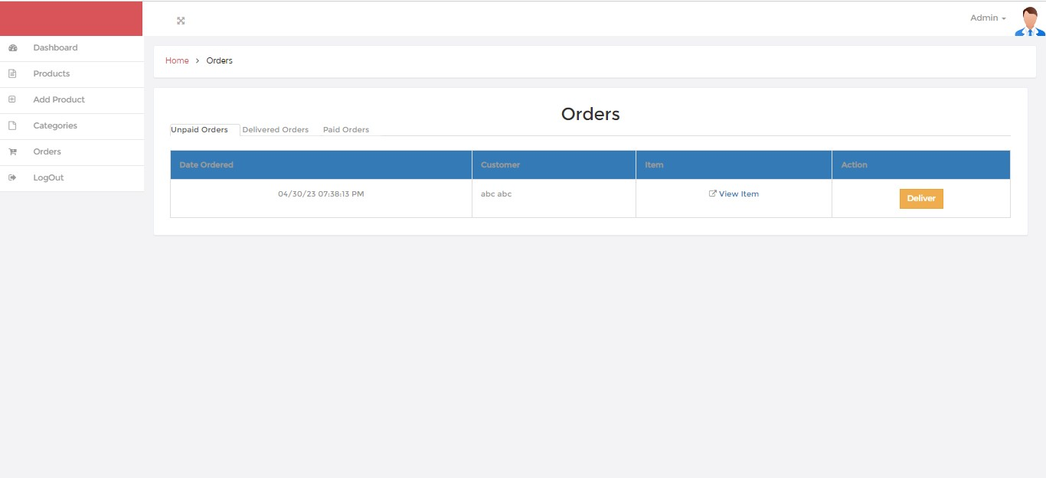
Order Statistics

Slide 19
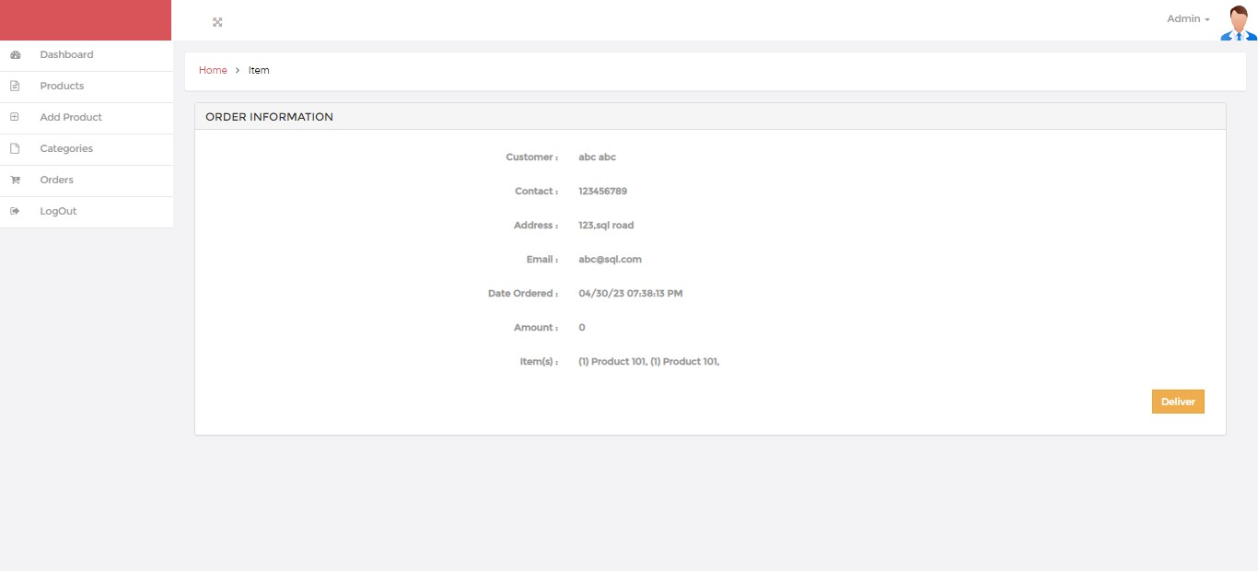
Order Information

Slide 20
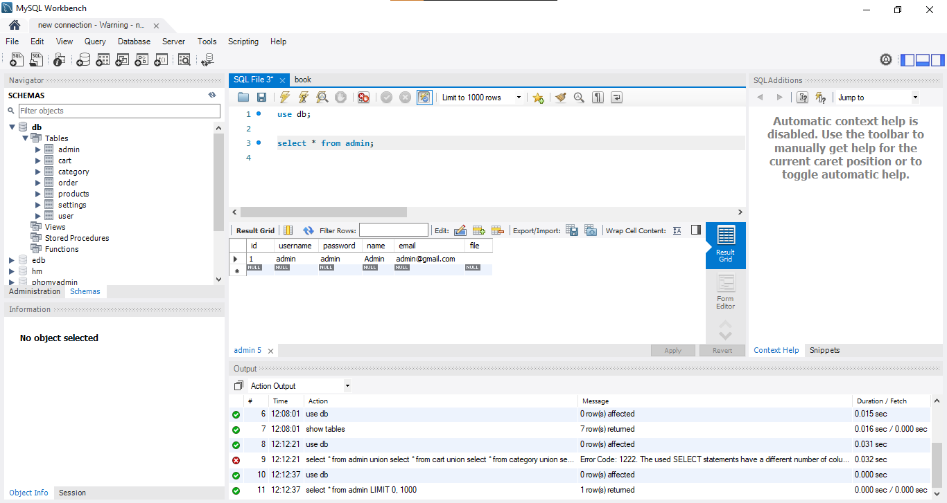
Database

Slide 21
SQL Injection
What is it?
How it works?

Slide 22
Past Incident of SQLi
Incidents
Jeff Forristal, a cybersecurity researcher and hacker, first noticed this in 1998.
Breach at 7-Eleven: 130 million credit card details were stolen after a group of criminals used SQL injection to get into corporate systems at multiple businesses, particularly the 7-Eleven convenience store network.
SQL injection's effects on your apps
Steal credentials—Through SQLi, attackers can gain credentials, which they can then use to pose as users and access resources.
Access databases – Attackers can access the private information stored on database servers.
Change or upload new data to the accessible database—attackers have this option.
erase data: Attackers are able to dump whole tables or erase database records.
Attackers can exploit operating system rights to access database servers, and they can then use these capabilities to access other sensitive systems.

Slide 23

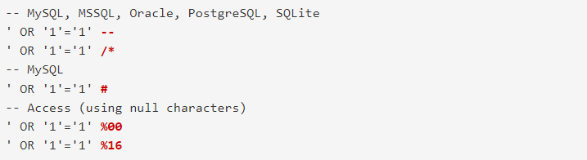
SQLi with an example
Simple SQL Injection
If your username is "jsmith" and your password is "P@$$w0rd," choose ID from Users.
Select ID from Users with the criteria "jsmith" and "x" or 1=1
It is not required that this be a 1=1 condition. Workable values include 2=2, 4726=4726, or even a=a.

Slide 24
SQLi with an example
Union-Based SQL Injection
In this case, we combine two SQL requests

Slide 25
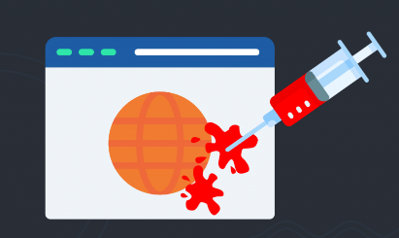
Preventing SQL injection
Generally, the following 6 steps can be used to prevent SQLi
STEP 1: Maintain and practice attentiveness
STEP 2: All user inputs are untrusted
STEP 3: Use whitelists rather than blacklists.
STEP 4: Adopt latest technologies
STEP 5: Employ Verified Steps
STEP 6: Scan regularly

Slide 26
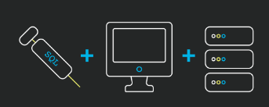
SQL Injection Prevention in our app(PHP)
Parameterized Queries
PHP Data Objects
User input Validation and filtering mechanisms
Avoided dynamic SQL queries
Used database privileges and access controls to limit the permissions of database users
Used SQL Map to identify SQL injection vulnerabilities in the application

Slide 27
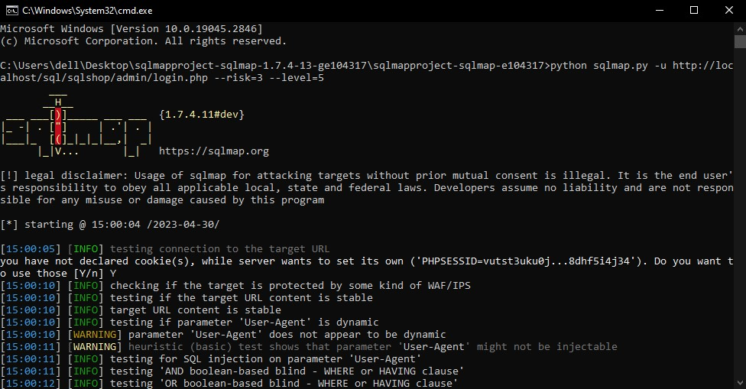
SQL MAP

Slide 28

Thank You

